Slide 1
Airline Satisfaction
Dream of Data
Shan (Scarlett) Chen
Hanqing (Zack) Chen
Szufan (Saki) Chen
Kunyu (Ruth) Cheung
Hector Cadeaux
Notes:
Good evening. We are Dream of Data, comprised of Scarlett, Saki, Zack, Ruth and, myself, Hector. We will be talking to you about the Airline Satisfaction dataset from Kaggle.

Slide 2
Business Problem & Project Goal
Business problem - A difficult time for airline industry
Revenue drops while cost increases
Shrinking margins
Project goal - How to keep customers happy?
Find a correlation between 23 variables and the satisfaction of customers
Notes:
The airlines were doing great in 2018. The airlines saw $38.4 billion in revenue in North America alone. But, unfortunately, by the end of 2020, they were receiving aid of $170 billion worldwide. The airline industry can be complex. Factors such as congestion, terrorism, oil prices, and labor disputes make it difficult to profit. For many airlines, it has become essential to make customers happy to ensure the business's survival. The airlines want to ensure that they can keep planes flying. It is with this thought that our dataset was created. The fictional company, Invisitico, was created to mask the data. Our challenge is to find a correlation between customer satisfaction and 23 other variables.

Slide 3
Finding the Root Cause of Satisfaction
Exploration
Baseline Modeling
K means and PCA
H2O libraries
XGBoost, Grid Search, Stacked Ensemble and Auto ML
Insights

Slide 4
Libraries Used
pandas, numpy
matplolib’s pyplot, seaborn
warnings
sklearn.cluster, KMeans
sklearn.decomposition, PCA
dmba
sklearn.naive_bayes , RandomForestClassifier
sklearn.metrics
KFold, cross_validate
Notes:
We used the machine learning libraries from sklearn and H2O

Slide 5
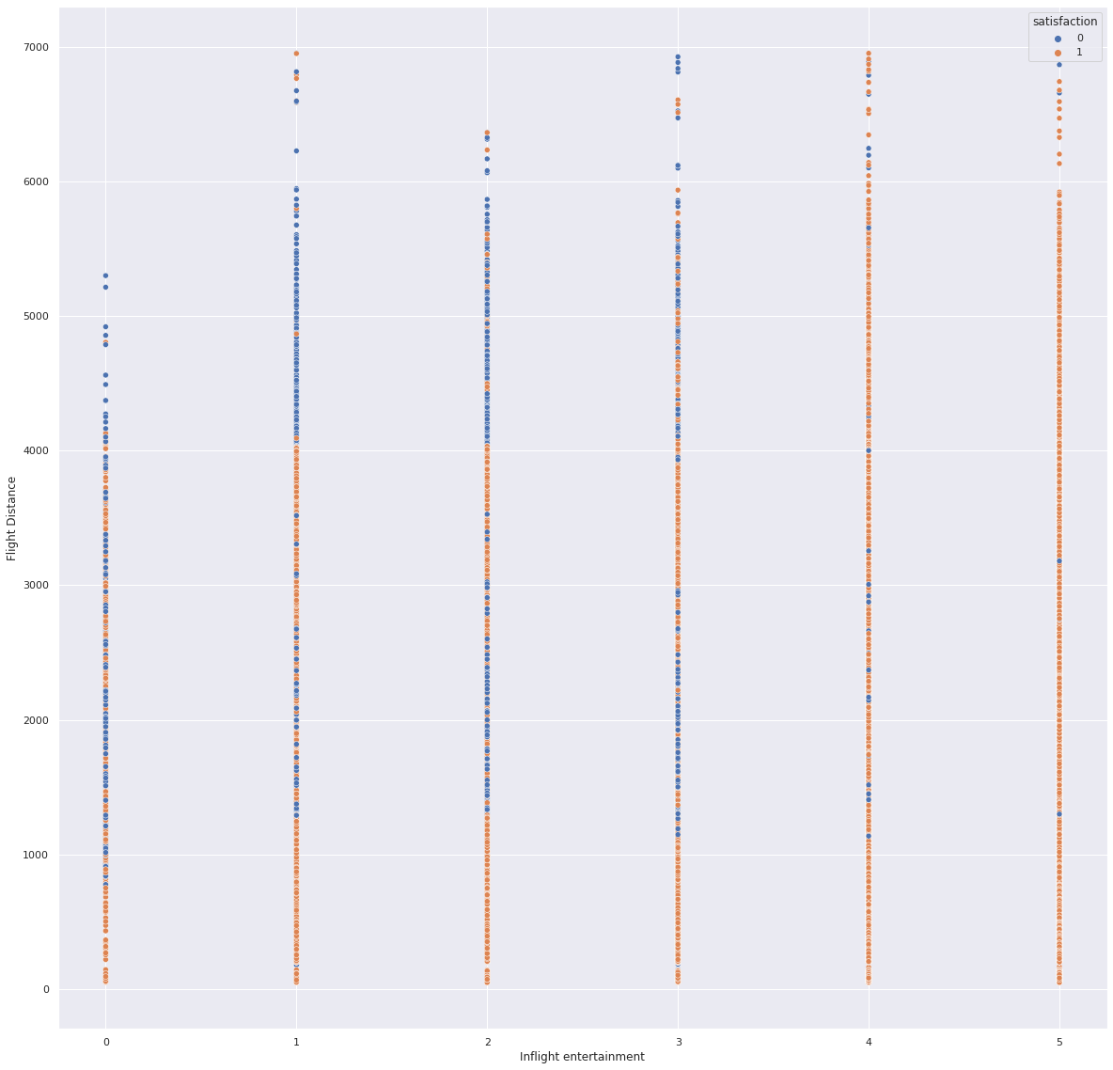
Exploration - Dataset
130 thousand surveys conducted
23 Variables
Outcome variable ‘satisfaction’
4 numerical variables
393 missing values
55% satisfied
Notes:
To the right you will find a graph of inflight entertainment scores to Flight distance

Slide 6
Exploration - Dataset
Average age of customer is 39.5
Average flight distance is 2000 miles.
Almost 51% Female
A little over 80% of customers are loyal
Roughly 70% of customers are business travellers
Business class (48%), Economy class (45%) , and Economy Plus contributes 7% of total.
Cleanliness receives the highest average rating score of all (3.7/5)
Seat comfort has the lowest average rating (2.83/5)
Notes:
Out of 130 thousand surveys conducted that have 23 different variables, with roughly 55% satisfaction rate, the average age of customer is 39.5, and average flight distance is 2000 miles. There are slightly more female customers than male customers; A little over 80% of customers are loyal; Roughly 70% of customers are business travellers; Class is split almost evenly between business and economy class, with economy plus contributes to 7.24% of total. For bar graphs that show customer ratings for different types of services, with a maximum score of 5, cleanliness receives the highest average rating score of all (3.7), while seat comfort has the lowest average rating (2.83).

Slide 7
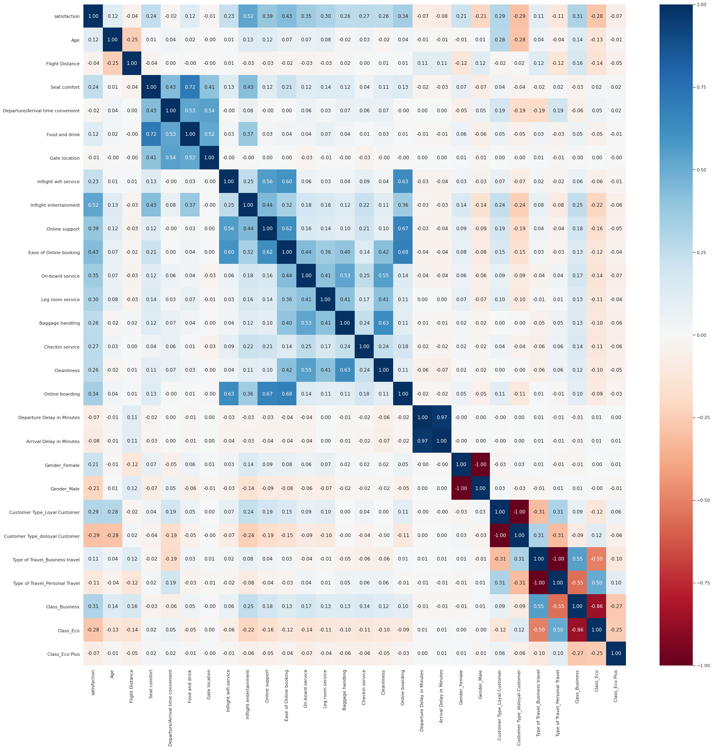
Exploration - Correlation Matrix
Top 3 variables
'Inflight entertainment' (0.52)
'Ease of online booking' (0.43)
'Online support' (0.39)
Notes:
The heat map represents the correlation between our numeric variables and target variable 'Satisfaction.' The top 3 variables that have the highest correlation to 'Satisfaction' are: 'Inflight entertainment' (0.52), 'Ease of online booking' (0.43), and 'Online support' (0.39).

Slide 8
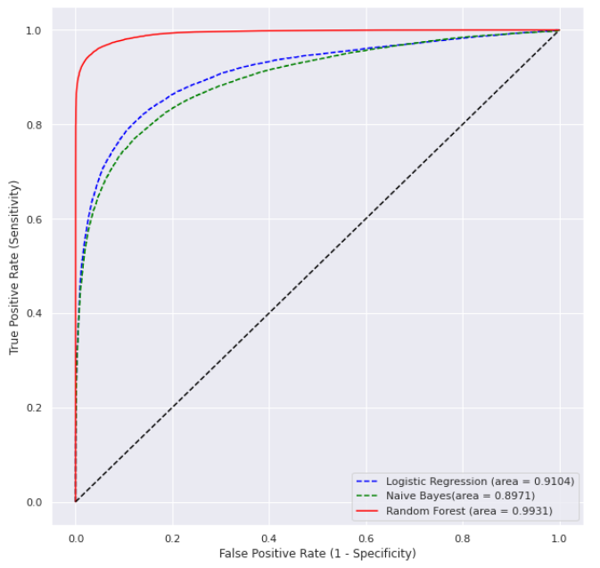
Baseline
Used Random Forest, Naive Bayes and Logistic Regression
Random Forest generated best AUC
All three generated models higher than .88
The F-1 metric was chosen going forward
 | Logistic Regression | Naive Bayes | Random Forest
F-1 | .8502 | .8341 | .9605
AUC | .9104 | .8971 | .9931
Notes:
F-1 minimized the results of the true negative while giving us an average of precision and recall

Slide 9
K-means and PCA
K-means
3 clusters chosen
No improvement to the model
PCA
11 attributes selected, 80% attributed
Naive Bayes showed minimal improvement
Logistic Regression | Naive Bayes | Random Forest
.8482 | .8318 | .9577
Logistic Regression | Naive Bayes | Random Forest
.8411 | .8350 | .9242
Continued with original dataset into hyperparameter optimization
Notes:
I will now hand things off to Zach, who will speak to you about H2O optimization and Insights

Slide 10
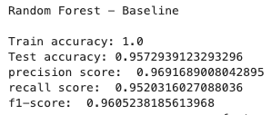
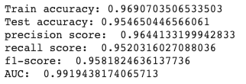
Hyperparameter Tuning for Random Forest
Random Forest performs better than the other two models so we would like to do hyperparameter tuning on Random Forest to see whether we can improve the model performance.
Parameter grid = {‘n_estimators’ : [100, 200], ‘max_depth’ : [50, 100], ‘min_samples_split : [30]’}
The f1-score was 0.9605 when using default parameters from scikit learn. The f1-score is 0.9582 on the best parameter set (n_estimators = 200, max_depth = 100, min_samples_split = 30). It doesn't increase the performance of random forest.
Notes:
Since baseline random forest model received the highest f-1 score of all three, we wanted to perform hyperparameter tuning on the baseline random forest model to see if we can further improve the result.
For parameter selection, we are using ‘n_estimators’ with 100 and 200, and ‘max_depth’ with 50 and 100 for the parameter grid. A combination of ‘n_estimators’ of 200 and ‘max_depth’ of 100 results the best f-1 score of 0.9582, which falls a little be short comparing to the baseline model.

Slide 11
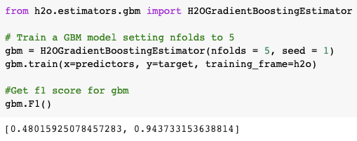
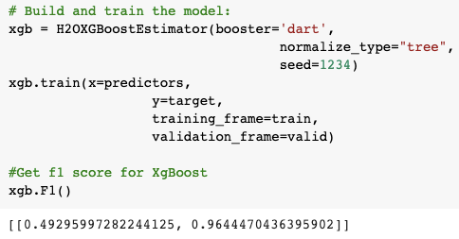
Gradient Boosted Machines & XgBoost
We built Gradient Boosted Machines and used XgBoost.
The GBM model decreased F1 score
XgBoost managed to increase the F1 score to maximum of 0.9644
Notes:
Because we are using random forest model as our main model, we also wanted to use gradient boosted machine for comparison. the baseline gradient boosted machine achieved a lower f-1 score of 0.9437, using xg boost imported from h2o library improves the score to 0.9644, which is slightly better than baseline random forest model.

Slide 12

Grid Search for Parameter Optimization
GridSearchCV for hyperparameter tuning:
The best parameters combination is when ---
'learn_rate' equals to 0.01, 'max_depth' is 9, and 'ntrees' gets 100.
Original RF | GridSearchCV with XgBoost | H2OGridSearch
0.9605 | 0.9781 | 0.9620
Notes:
We performed grid search on gradient boosted machine as well, to try to achieve the parameters that would give us the best result.
With Grid search cross validation with xg boost, for our GBM parameter selection, we used 0.01 and 0.1 for ‘learn_rate;’ 3, 5, and 9 for ‘max_depth,’ and our ‘n_trees’ with 100, 200, and 300.
We found out the best parameter combination is learn_rate' equals to 0.01, 'max_depth' is 9, and 'ntrees' gets 100.learn_rate' equals to 0.01, 'max_depth' is 9, and 'ntrees' gets 100.
We managed to increase the f1 score to 0.9781, compared with 0.9609 when using baseline model of random forest.
We got f1 of 0.9620 with H2O grid search, which is better than baseline data with random forest

Slide 13
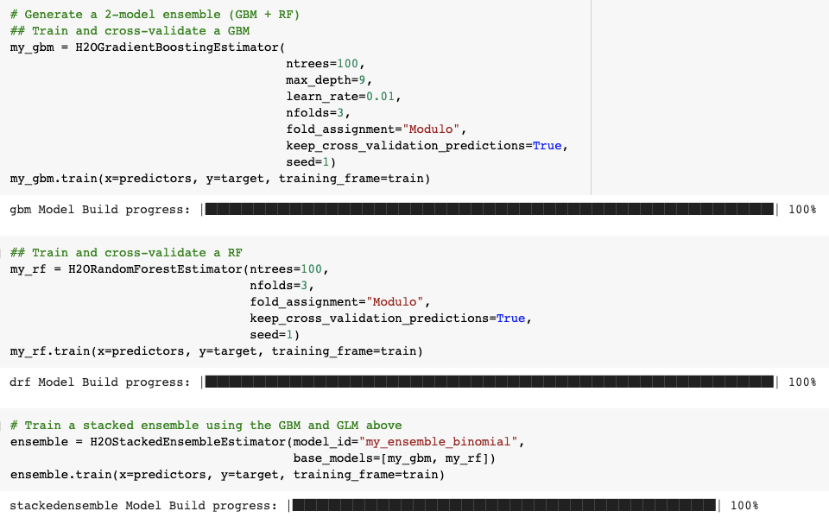
H2O Stacked Ensemble for RF and GBM
Using H2O ensemble, we built and stacked 2 models: gradient boosted machine, and random forest.
F1 score is 0.9597 after stacked ensemble.

Slide 14
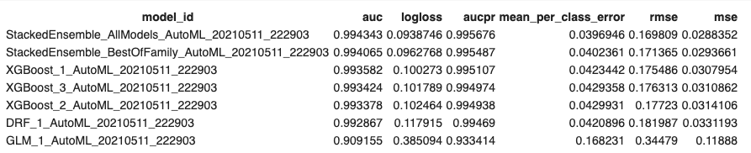
Auto ML Lead board
The table below shows the AUC values of all models built based on H2O. And the StackedEnsemble gives us the best result according to Automl.

Slide 15
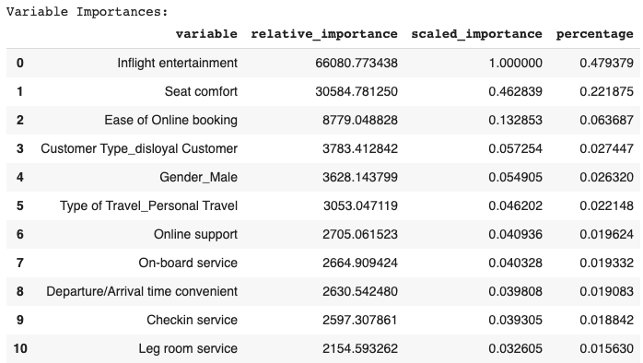
Insights - Important Variables
Ranked variable importance from GBM model

Slide 16
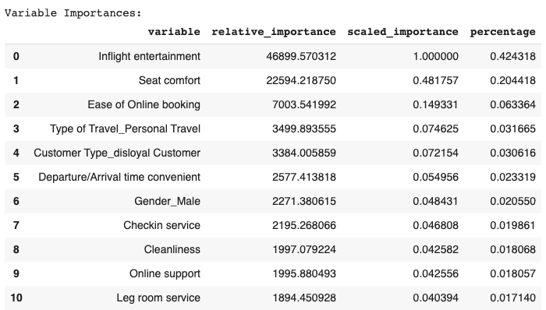
Insights - Important Variables
Ranked variable importance from best_GBM after parameter optimization

Slide 17
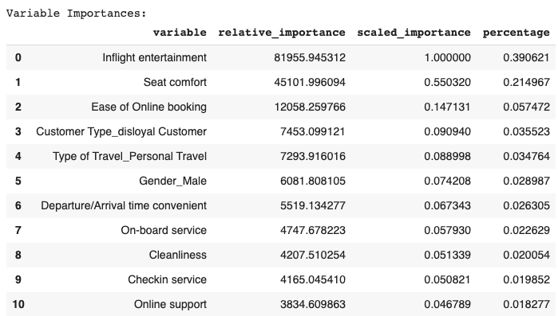
Insights - Important Variables
Ranked variable importance from XgBoost model

Slide 18
Insights - Important Variables
Top 3 according to the models
‘Inflight entertainment’, ‘Seat comfort’, and ‘Ease of Online booking’
Top 3 variables according to correlation matrix
'Inflight entertainment', 'Online support', 'Ease of Online booking'
Less influential but still relevant
Customer loyalty, Gender, Type of travel
To increase satisfaction, the company should focus on implementing inflight entertainment, increase seat comfortness and make it easier to booking a ticket online.
Notes:
After comparing the variable importances within the 3 models, we noticed that ‘Inflight entertainment’, ‘Seat comfort’, and ‘Ease of Online booking’ are always the top 3 most important variables among all. And customer loyalty, gender, type of travel are around 3% likely to influence customer satisfaction.
Our model indicates the importance of variable ‘seat comfort’ to the customer satisfaction, which is different from what the top 3 variables are according to correlation matrix.
To increase satisfaction, the company should focus on implementing inflight entertainment, increase seat comfortness and make it easier to booking a ticket online.

Slide 19
Suggestion
Inflight Entertainment
Entertainment for the economy class
Entertainment catering to younger generations
Seat Comfort
Increase the seat comfortness
Enable seat selection by emphasizing seats with fewer passengers around or infants nearby
Ease of Online Booking
Recommend ticket class and refund options based on the personal data
Inflight Service
Friendly flight attendants
In-time service
Notes:
1.For long flights, adding more inflight entertainment features for the economy class will likely improve overall satisfaction most effectively. Targeting the entertainment preferences of younger generations may prove advantageous. We recommend replacing obsolete shopping magazines and newspapers with fashion magazines and comic books and adding more popular movies and games to personal video screens to make long flights more tolerable.
2. The variable 'seat comfort' is also an essential factor for customer satisfaction. Increasing the seat comfort could lead to better rest for customers during a flight. To further improve inflight rest, Invistico could improve seat selection for passengers looking to rest by emphasizing seats surrounded by fewer passengers or nearby infants.
3. Currently, Invistico provides multiple pricing strategies and restrictions to the same flight seat. The flexibility decreases when customers book online; 'Ease of Online booking' is also an important factor for customer satisfaction. We recommend that the airline company target long-distance route customers based on the customer's personal data(age/ gender/ type of travel) to provide airfare recommendations. For example, young passengers are most likely price-sensitive and may not spend on the ticket change fee. Investico can recommend the cheaper but nonrefundable and unchangeable flight choices, thereby reducing the complexity of the passenger's choice.
4. For the 4th point, we want to draw the attention to inflight services provided. Although it’s not included in our dataset, the survey report shows the passenger satisfaction is at an all-time high for the airline industry during pandemic.

Slide 20
ANY QUESTIONS ?
Notes:
After comparing the variable importances within the 3 models, we noticed that ‘Inflight entertainment’, ‘Seat comfort’, and ‘Ease of Online booking’ are always the top 3 most important variables among all. And customer loyalty, gender, type of travel are around 3% likely to influence customer satisfaction.
To increase satisfaction, the company should focus on implementing inflight entertainment, increase seat comfortness and make it easier to booking a ticket online.

Slide 21
References
Dataset https://www.kaggle.com/sjleshrac/airlines-customer-satisfaction
IATA. (2020, November). Economic Performance of the Airline Industry. https://www.iata.org/en/iata-repository/publications/economic-reports/airline-industry-economic-performance---november-2020---report/
Kho, J. (2019, March 12). Why random forest is my favorite machine learning model. Medium. https://towardsdatascience.com/why-random-forest-is-my-favorite-machine-learning-model-b97651fa3706
OEDC. (2020, October 15). COVID-19 and the aviation industry: Impact and policy responses. https://www.oecd.org/coronavirus/policy-responses/covid-19-and-the-aviation-industry-impact-and-policy-responses-26d521c1/
O'Hare, M. (2019, December 23). The most talked-about aviation moments in 2019. https://www.cnn.com/travel/article/aviation-year-in-review-2019/index.html
Popken, B. (2020, December 28). 2020 was brutal for airlines. Next year could be even trickier. https://www.nbcnews.com/business/business-news/2020-was-brutal-airlines-next-year-could-be-even-trickier-n1252436
Reid, D. (2017, December 5). US airlines to scoop almost half of global profit in 2018. https://www.cnbc.com/2017/12/05/us-airlines-to-scoop-almost-half-of-global-profit-in-2018.html
Reid, D. (2018, June 4). Airline profits to slump in 2018, industry body says. https://www.cnbc.com/2018/06/04/iata-forecasts-airline-profit-fall-in-2018.html
Zhang, B. (2018, April 15). Airlines are making more money than ever — but they're facing a mountain of problems. Business Insider. https://www.businessinsider.com/airlines-biggest-business-problems-2018-4
Study: Airline passenger satisfaction hits record high during pandemic https://www.ajc.com/news/business/study-airline-passenger-satisfaction-hits-record-high-during-pandemic/PFVBH7RTQVGOXLHCUO5JSY3PXA/#:~:text=Satisfaction%20reached%20a%20score%20of,for%20those%20that%20do%20fly.%E2%80%9D
Notes:
After comparing the variable importances within the 3 models, we noticed that ‘Inflight entertainment’, ‘Seat comfort’, and ‘Ease of Online booking’ are always the top 3 most important variables among all. And customer loyalty, gender, type of travel are around 3% likely to influence customer satisfaction.
Our model indicates the importance of variable ‘seat comfort’ to the customer satisfaction, which is different from what the top 3 variables are according to correlation matrix.
To increase satisfaction, the company should focus on implementing inflight entertainment, increase seat comfortness and make it easier to booking a ticket online.

